Slide 1

Unit-01 Introduction to Python, Object and Data Structure
Python Programming(2101CS405)
Prof. Jayesh D. Vagadiya
Computer Engineering Department
Jayesh.vagadiya@darshan.ac.in
9537133260

Slide 2

Outline
Introduction to python
Advantages of python
Installing python
Hello World program using python
Indentations
Print() function
Input() function
Data types
Variables
Expressions
Functions
String
List
Tuple
Set
Dictionary
List Comprehension
Looping

Slide 3
Syllabus
Sr. No. | Unit
1 | Introduction to Python, Object and Data Structure
2 | Python Operators, Conditional and Looping Statements, Functions in Python
3 | File IO in Python, Exception handling
4 | Modules, Matplotlib
5 | Object Oriented Programming with Python
Reference Book:
Programming in Python 3 : A Complete Introduction to the Python Language
Introduction to Computation and Programming Using Python
Core Python Programming

Slide 4

Introduction to Python
Python is an open source, interpreted, high-level, general-purpose programming language.
Python's design philosophy emphasizes code readability with its notable use of significant whitespace.
Python is dynamically typed and garbage-collected language.
Python was conceived in the late 1980s as a successor to the ABC language.
Python was Created by Guido van Rossum and first released in 1991.
Python 2.0, released in 2000,
introduced features like list comprehensions and a garbage collection system with reference counting.
Python 3.0 released in 2008 and current version of python is 3.11.0 (as of Nov 2022).
The Python 2 language was officially discontinued in 2020

Slide 5
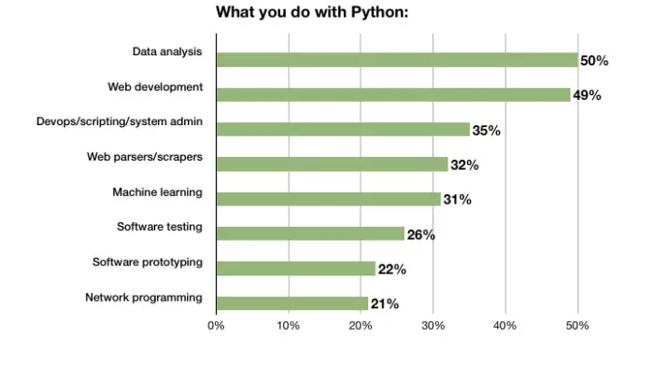
Why Python ?

Slide 6
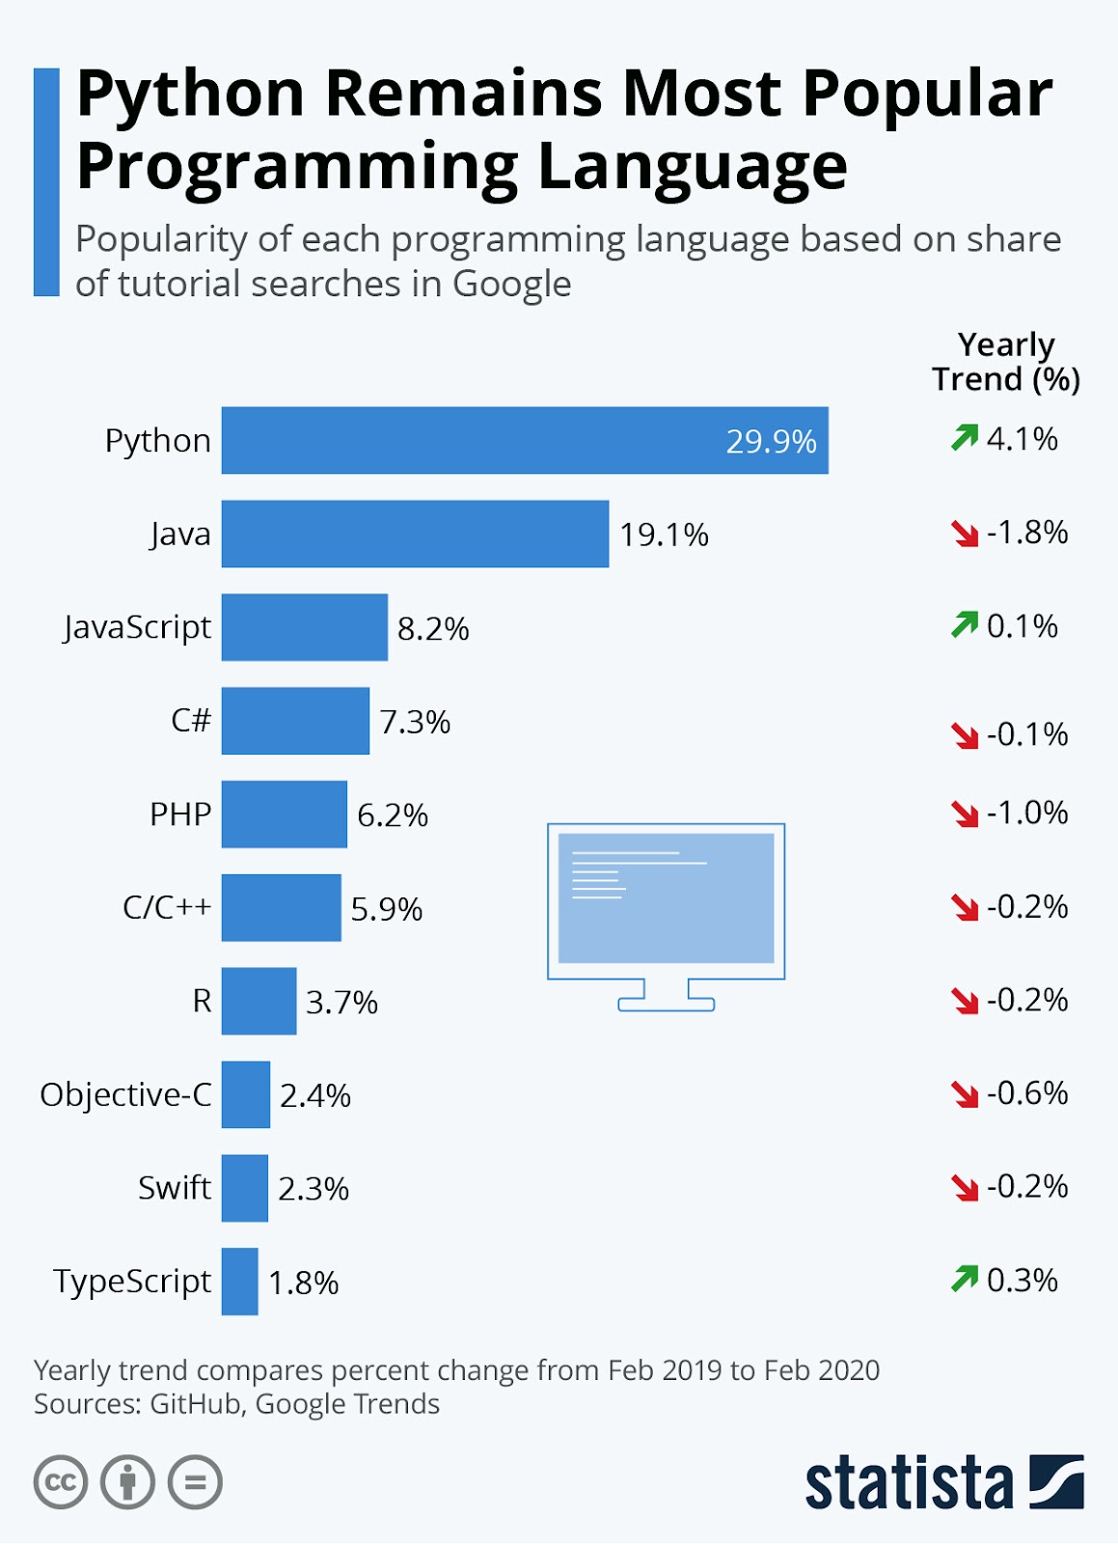
Why Python ?

Slide 7
Why Python?
Python has many advantages
Easy to Read, Learn and Write
Python is a high-level programming language that has English-like syntax. This makes it easier to read and understand the code.
Improved Productivity
Python is a very productive language. Due to the simplicity of Python, developers can focus on solving the problem.
Interpreted Language
Python is an interpreted language which means that Python directly executes the code line by line. In case of any error, it stops further execution and reports back the error which has occurred.
Dynamically Typed
python automatically assigns the data type during execution. The programmer doesn’t need to worry about declaring variables and their data types.

Slide 8
Why Python? (cont.)
Free and Open-Source
Python comes under the OSI approved open-source license. This makes it free to use and distribute.
The Python Software Foundation distributes pre-made binaries that are freely available for use on all major operating systems called CPython.
You can get CPython’s source-code, too. Plus, you can modify the source code and distribute it as allowed by CPython’s license.
Vast Libraries Support
The standard library of Python is huge, you can find almost all the functions needed for your task. So, you don’t have to depend on external libraries.
Portability
In many languages like C/C++, you need to change your code to run the program on different platforms. That is not the same with Python. You only write once and run it anywhere.
Python runs on all major operating systems like Microsoft Windows, Linux, and Mac OS X.

Slide 9
Why Python? (cont.)
It’s Safe
Python doesn’t have pointers like other C-based languages, making it much more reliable.
Along with that, errors never pass silently unless they’re explicitly silenced.
This allows you to see and read why the program crashed and where to correct your error.
High-Level Language
Python looks more like a readable, human language than like a low-level language.
This gives you the ability to program at a faster rate.

Slide 10
Installing Python
For Windows & Mac:
To install python in windows you need to download installable file from https://www.python.org/downloads/
After downloading the installable file you need to execute the file.
For Linux :
For ubuntu 16.10 or newer
sudo apt-get update
sudo apt-get install python3.8
To verify the installation
Windows :
python --version
Linux :
python3 --version (linux might have python2 already installed, you can check python 2 using python --version)
Alternatively we can use anaconda distribution for the python installation
http://anaconda.com/downloads
Anaconda comes with many useful inbuilt libraries.

Slide 11
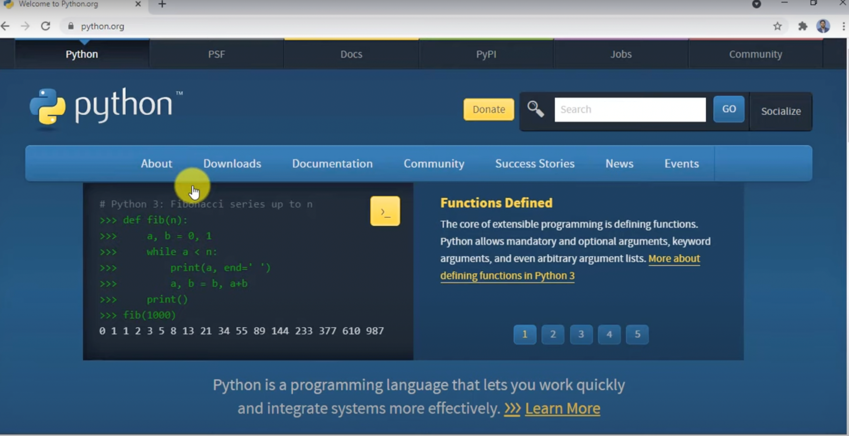
Step – 1 open python.org

Slide 12
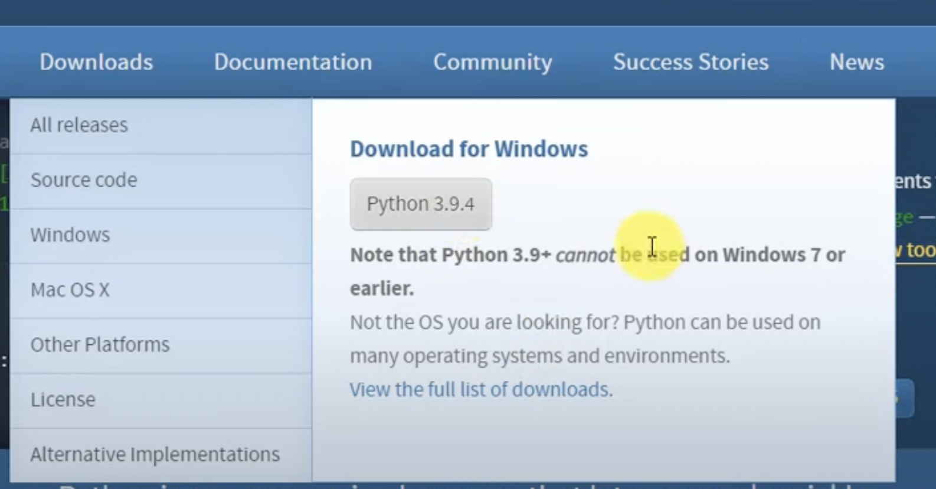
Step-2 goto download the python version (exe file)

Slide 13
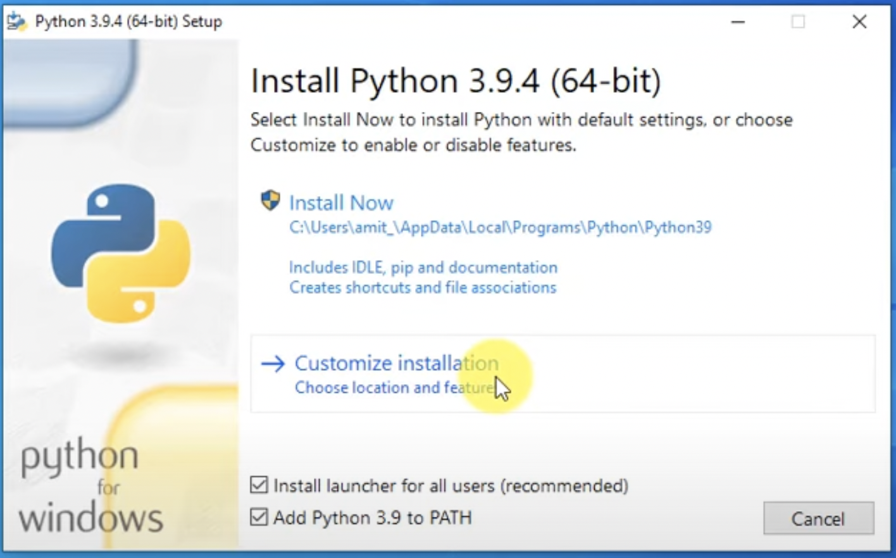
Step – 3 run exe and select Customize Installation

Slide 14
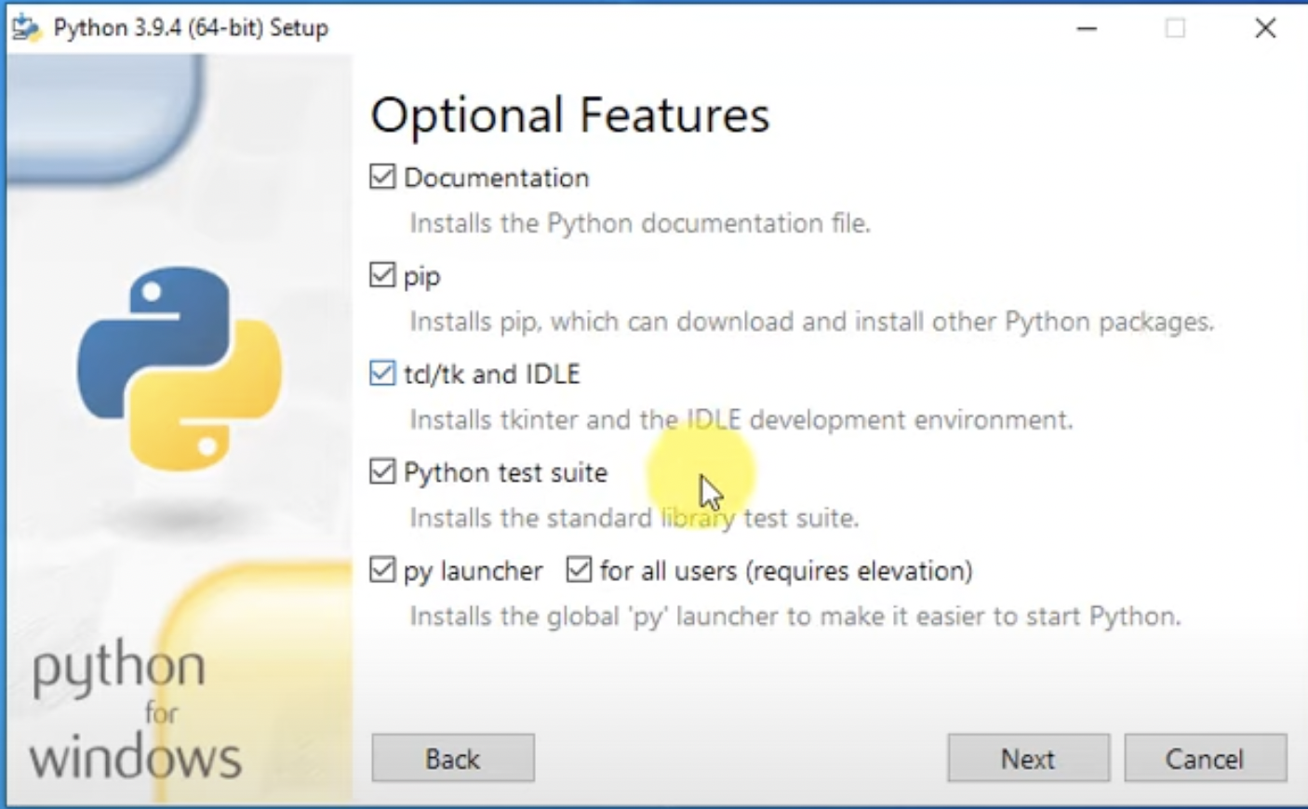
Step – 4 select all option features

Slide 15
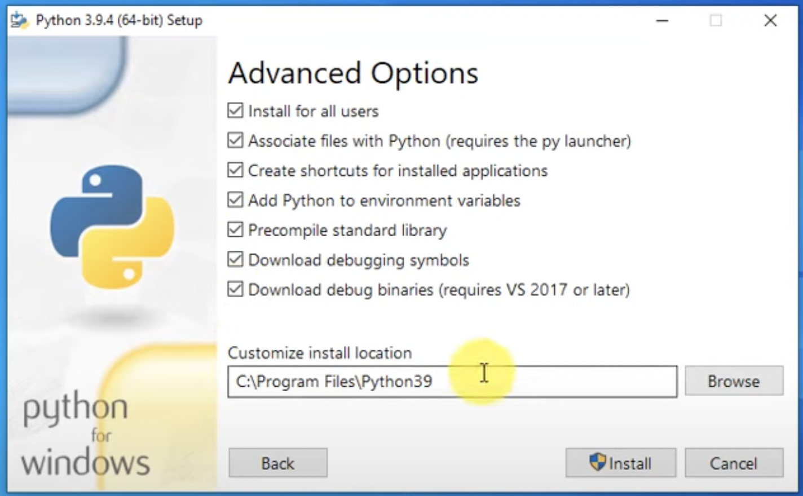
Step – 5 Select advanced options

Slide 16
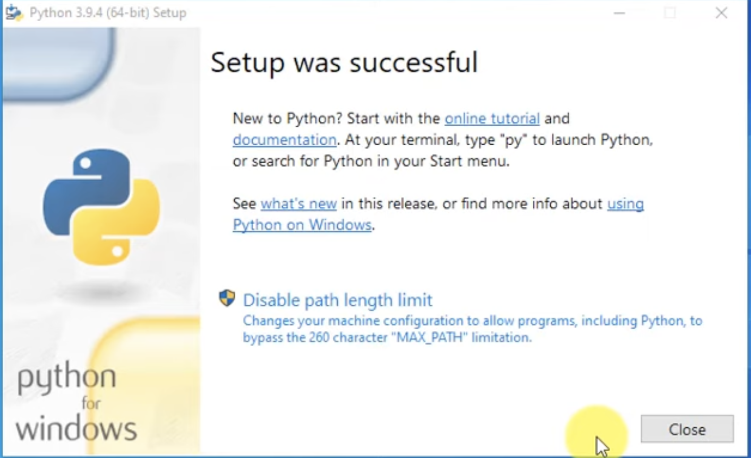
Step – 5 installation Completed

Slide 17
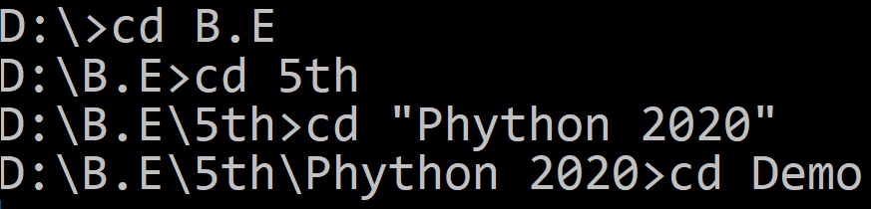

Hello World using Python
To write python programs, we can use any text editors or IDE (Integrated Development Environment), Initially we are going to use Visual Studio Code.
Create new file in editor, save it as first.py (Extensions for python programs will be .py)
To run the python file open command prompt and change directory to where your python file is
Next, run python command (python filename.py)
first.py
Python line does not end with ;
1
print("Hello World from python")

Slide 18
Indentation in python
Indentation in general means indenting words or spaces or lines in the document to follow the styling rule for documentation
Indentation in Python refers to the (spaces and tabs) that are used at the beginning of a statement.
The statements with the same indentation belong to the same group called a suite.
In many different programming languages like C, C++, Java, etc. use flower brackets or braces {} to define or to identify a block of code in the program, whereas in Python, it is done using the spaces or tabs, which is known as indentation and also it is generally known as 4 space rule in Pep8 documentation of rules for styling and designing the code for Python.
Example.py
1
2
3
4
5
if Condition:
print("True")
else:
print("False")
IndentationError: unindent does not match any outer indentation level

Slide 19
print() Function
The print() function prints the specified message to the screen, or other standard output device.
the object will be converted into a string before written to the screen.
Syntax
1
print(object(s), sep=separator, end=end)
Parameter Name | Description
Object(s) | Any number of objects. Will be converted into string before printing.
sep | Optional. Specify how to separate the objects, if there is more than one. Default is ' '
end | Optional. Specify what to print at the end. Default is '\n'

Slide 20
input() Function
The input() function allows user to enter values.
Whatever you enter as input, the input function converts it into a string. If you enter an integer value still input() function convert it into a string.
Syntax
1
input(prompt)
Parameter Name | Description
prompt(s) | A String, representing a default message before the input.

Slide 21
Example
Example.py
Output
1
2
3
4
5
6
7
9
10
11
12
13
14
a = 4
str = input("Enter your name = ")
num = int(input("Enter Number = "))
print(4,5)
print("Hello","World")
print("Hello","World",sep="-")
print("Hello","DU",sep="-",end=" ")
print("Hello " + "DU ")
print("a = ", a,end=", ")
print("num = ", num)
print("your Name ="+ str)
print("Your Name ",str,sep="=")
Enter your name = ABC
Enter Number = 10
4 5
Hello World
Hello-World
Hello-DU Hello DU
a = 4, num = 10
your Name =ABC
Your Name =ABC

Slide 22
Program 1
WAP to develop simple calculator in python
Example1.py
1
2
3
4
5
6
number1 = int(input("Enter first number: "))
number2 = int(input("Enter second number: "))
print(number1, "+", number2, "=", number1+number2)
print(number1, "*", number2, "=", number1*number2)
print(number1, "-", number2, "=", number1-number2)
print(number1, "/", number2, "=", number1/number2)
Output
Enter first number: 3
Enter second number: 3
3 + 3 = 6
3 * 3 = 9
3 - 3 = 0
3 / 3 = 1.0

Slide 23
Program 2
WAP to calculate simple interest
Example2.py
1
2
3
4
5
P = int(input("Enter P: "))
R = int(input("Enter R: "))
T = int(input("Enter N: "))
Simple_interest = (P * R * T) / 100
print("The simple interest is:", Simple_interest)
Output
Enter P: 10000
Enter R: 5
Enter N: 1
The simple interest is: 500.0

Slide 24
Program 3
WAP to calculate area of circle.
Example3.py
1
2
3
4
PI = 3.14
r = float(input("Enter the radius of a circle:"))
area = PI * r * r
print("Area of a circle = %.2f" %area)
Output
Enter the radius of a circle:100
Area of a circle = 31400.00

Slide 25
Data types in Python
Name | Type | Description
Data Types
Integer | int | Whole number such as 0,1,5, -5 etc..
Float | float | Numbers with decimal points such as 1.5, 7.9, -8.2 etc..
String | str | Sequence of character (Ordered) such as “darshan”, ‘college’, “રાજકોટ” etc..
Boolean | bool | Logical values indicating Ture or False (T and F here are capital in python)
Data Structures
List | list | Ordered Sequence of objects, will be represented with square brackets [ ] Example : [ 18, “darshan”, True, 102.3 ]
Tuple | tup | Ordered immutable sequence of objects, will be represented with round brackets ( ) Example : ( 18, “darshan”, True, 102.3 )
Set | set | Unordered collection of unique objects, will be represented with the curly brackets { } Example : { 18, “darshan”, True, 102.3 }
Dictionary | dict | Unordered key : value pair of objects , will be represented with curly brackets { } Example : { “college”: “darshan”, “code”: “054” }

Slide 26
Variables in Python
A Python variable is a reserved memory location to store values.
Unlike other programming languages, Python has no command for declaring a variable.
A variable is created the moment you first assign a value to it.
Python uses Dynamic Typing so,
We need not to specify the data types to the variable as it will internally assign the data type to the variable according to the value assigned.
we can also reassign the different data type to the same variable, variable data type will change to new data type automatically.
We can check the current data type of the variable with type(variablename) in-built function.
Rules for variable name
Name can not start with digit
Space not allowed
Can not contain special character
Python keywords not allowed
Should be in lower case

Slide 27
Example of Python variable
Example :
demo.py
1
2
3
4
5
6
7
8
9
10
x = 10
print(x)
print(type(x))
y = 123.456
print(y)
x = "darshan insitute of engneering and technology"
print(x)
print(type(x))
Reassign same variable to hold different data type
Run in terminal
1
python demo.py
Output
1
2
3
4
5
10
int
123.456
Darshan institute of engineering and technology
str

Slide 28
String in python
String is Ordered Sequence of character such as “darshan”, ‘college’, “રાજકોટ” etc..
Strings are arrays of bytes representing Unicode characters.
String can be represented as single, double or triple quotes.
String with triple Quotes allows multiple lines.
String in python is immutable.
Square brackets can be used to access elements of the string, Ex. “Darshan”[1] = a, characters can also be accessed with reverse index like “Darshan”[-1] = n.
String index
x = " D a r s h a n "
index = 0 1 2 3 4 5 6
Reverse index = -7 -6 -5 -4 -3 -2 -1

Slide 29
String functions in python
Python has lots of built-in methods that you can use on strings, we are going to cover some frequently used methods for string like
len()
count()
title(), lower(), upper()
istitle(), islower(), isupper()
find(), rfind(), replace()
index(), rindex()
Methods for validations like
isalpha(), isalnum(), isdecimal(), isdigit()
strip(), lstrip(), rstrip()
split
Etc..
Note : len() is not the method of the string but can be used to get the length of the string
lendemo.py
Output : 7 (length of “Darshan”)
1
2
x = "Darshan"
print(len(x))

Slide 30
String methods (cont.)
count() method will returns the number of times a specified value occurs in a string.
title(), lower(), upper() will returns capitalized, lower case and upper case string respectively.
countdemo.py
1
2
3
x = "Darshan"
ca = x.count('a')
print(ca)
Output : 2 (occurrence of ‘a’ in “Darshan”)
changecase.py
1
2
3
4
5
6
7
x = "darshan Institute, rajkot"
c = x.title()
l = x.lower()
u = x.upper()
print(c)
print(l)
print(u)
Output : Darshan Institute, Rajkot
Output : darshan institute, rajkot
Output : DARSHAN INSTITUTE, RAJKOT

Slide 31
String methods (cont.)
istitle(), islower(), isupper() will returns True if the given string is capitalized, lower case and upper case respectively.
strip() method will remove whitespaces from both side of the string and returns the string.
rstrip() and lstrip() will remove whitespaces from right and left side respectively.
checkcase.py
1
2
3
4
5
6
7
x = 'darshan institute, rajkot'
c = x.istitle()
l = x.islower()
u = x.isupper()
print(c)
print(l)
print(u)
Output : False
Output : True
Output : False
stripdemo.py
1
2
3
x = ' Darshan '
f = x.strip()
print(f)
Output : Darshan (without space)

Slide 32
String methods (cont.)
find() method will search the string and returns the index at which they find the specified value
rfind() will search the string and returns the last index at which they find the specified value
Note : find() and rfind() will return -1 if they are unable to find the given string.
replace() will replace str1 with str2 from our string and return the updated string
finddemo.py
1
2
3
x = 'darshan institute, rajkot, india'
f = x.find('in')
print(f)
Output : 8 (occurrence of ‘in’ in x)
rfinddemo.py
1
2
3
x = 'darshan institute, rajkot, india'
r = x.rfind('in')
print(r)
Output : 27 (last occurrence of ‘in’ in x)
replacedemo.py
1
2
3
x = 'darshan institute, rajkot, india'
r = x.replace('india','INDIA')
print(r)
Output : “darshan institute, rajkot, INDIA”

Slide 33
String methods (cont.)
index() method will search the string and returns the index at which they find the specified value, but if they are unable to find the string it will raise an exception.
rindex() will search the string and returns the last index at which they find the specified value , but if they are unable to find the string it will raise an exception.
Note : find() and index() are almost same, the only difference is if find() is unable to find the string it will return -1 and if index() is unable to find the string it will raise an exception.
indexdemo.py
1
2
3
x = 'darshan institute, rajkot, india'
f = x.index('in')
print(f)
Output : 8 (occurrence of ‘in’ in x)
rindexdemo.py
1
2
3
x = 'darshan institute, rajkot, india'
r = x.rindex('in')
print(r)
Output : 27 (last occurrence of ‘in’ in x)

Slide 34
String methods (cont.)
isalnum() method will return true if all the characters in the string are alphanumeric (i.e either alphabets or numeric).
isalpha() and isnumeric() will return true if all the characters in the string are only alphabets and numeric respectively.
isdecimal() will return true is all the characters in the string are decimal.
Note : isnuberic() and isdigit() are almost same, you suppose to find the difference as Home work assignment for the string methods.
isalnumdemo.py
1
2
3
x = 'darshan123'
f = x.isalnum()
print(f)
Output : True
isdecimaldemo.py
1
2
3
x = '123.5'
r = x.isdecimal()
print(r)
Output : True

Slide 35
String Slicing
We can get the substring in python using string slicing, we can specify start index, end index and steps (colon separated) to slice the string.
syntax
x = 'darshan institute of engineering and technology, rajkot, gujarat, INDIA'
subx = x[startindex:endindex:steps]
endindex will not be included in the substring
strslicedemo.py
1
2
3
4
5
6
7
8
9
10
11
x = 'darshan institute of engineering and technology, rajkot, gujarat, INDIA'
subx1 = x[0:7]
subx2 = x[49:55]
subx3 = x[66:]
subx4 = x[::2]
subx5 = x[::-1]
print(subx1)
print(subx2)
print(subx3)
print(subx4)
print(subx5)
Output : darshan
Output : rajkot
Output : INDIA
Output : drhnisiueo niern n ehooy akt uaa,IDA
Output : AIDNI ,tarajug ,tokjar ,ygolonhcet dna gnireenigne fo etutitsni nahsrad

Slide 36
String print format
str.format() is one of the string formatting methods in Python3, which allows multiple substitutions and value formatting.
This method lets us concatenate elements within a string through positional formatting.
We can specify multiple parameters to the function
strformat.py
1
2
3
4
x = '{} institute, rajkot'
y = x.format('darshan')
print(y)
print(x.format('ABCD'))
Output : darshan institute, rajkot
Inline function call
Output : ABCD institute, rajkot
strformat.py
1
2
3
4
x = '{} institute, {}'
y = x.format('darshan','rajkot')
print(y)
print(x.format('ABCD','XYZ'))
Output : darshan institute, rajkot
Inline function call
Output : ABCD institute, XYZ

Slide 37
String print format (cont.)
We can specify the order of parameters in the string
We can also specify alias within the string to specify the order
We can format the decimal values using format method
strformat.py
1
2
3
4
x = '{1} institute, {0}'
y = x.format('darshan','rajkot')
print(y)
print(x.format('ABCD','XYZ'))
Output : rajkot institute, darshan
Inline function call
Output : XYZ institute, ABCD
strformat.py
1
2
x = '{collegename} institute, {cityname}'
print(x.format(collegename='darshan',cityname='rajkot'))
Output : darshan institute, rajkot
strformat.py
1
2
3
per = (438 / 500) * 100
x = 'result = {r:3.2f} %'.format(r=per)
print(x)
Output : result = 87.60 %
width
precision

Slide 38
Data structures in python
There are four built-in data structures in Python - list, dictionary, tuple and set.
Lets explore all the data structures in detail…
Name | Type | Description
List | list | Ordered Sequence of objects, will be represented with square brackets [ ] Example : [ 18, “darshan”, True, 102.3 ]
Dictionary | dict | Unordered key : value pair of objects , will be represented with curly brackets { } Example : { “college”: “darshan”, “code”: “054” }
Tuple | tup | Ordered immutable sequence of objects, will be represented with round brackets ( ) Example : ( 18, “darshan”, True, 102.3 )
Set | set | Unordered collection of unique objects, will be represented with the curly brackets { } Example : { 18, “darshan”, True, 102.3 }

Slide 39
List
List is a mutable ordered sequence of objects, duplicate values are allowed inside list.
List will be represented by square brackets [ ].
Python does not have array, List can be used similar to Array.
We can use slicing similar to string in order to get the sub list from the list.
list.py
Output : institute (List index starts with 0)
1
2
3
4
5
6
my_list = ['darshan', 'institute', 'rkot']
print(my_list[1])
print(len(my_list))
my_list[2] = "rajkot"
print(my_list)
print(my_list[-1])
Output : 3 (length of the List)
Output : ['darshan', 'institute', 'rajkot']
Note : spelling of rajkot is updated
Output : rajkot (-1 represent last element)
list.py
1
2
my_list = ['darshan', 'institute', 'rajkot','gujarat','INDIA']
print(my_list[1:3])
Output : ['institute', 'rajkot']
Note : end index not included

Slide 40
List methods
append() method will add element at the end of the list.
insert() method will add element at the specified index in the list
extend() method will add one data structure (List or any) to current List
appendlistdemo.py
1
2
3
my_list = ['darshan', 'institute', 'rajkot']
my_list.append('gujarat')
print(my_list)
Output : ['darshan', 'institute', 'rajkot', 'gujarat']
insertlistdemo.py
1
2
3
4
my_list = ['darshan', 'institute', 'rajkot']
my_list.insert(2,'of')
my_list.insert(3,'engineering')
print(my_list)
Output : ['darshan', 'institute', 'of', 'engineering', 'rajkot']
extendlistdemo.py
1
2
3
4
my_list1 = ['darshan', 'institute']
my_list2 = ['rajkot','gujarat']
my_list1.extend(my_list2)
print(my_list1)
Output : ['darshan', 'institute', ‘rajkot', ‘gujarat']

Slide 41
List methods (cont.)
pop() method will remove the last element from the list and return it.
remove() method will remove first occurrence of specified element
clear() method will remove all the elements from the List
index() method will return first index of the specified element.
poplistdemo.py
1
2
3
4
my_list = ['darshan', 'institute','rajkot']
temp = my_list.pop()
print(temp)
print(my_list)
Output : rajkot
Output : ['darshan', 'institute‘]
removelistdemo.py
1
2
3
my_list = ['darshan', 'institute', 'darshan','rajkot']
my_list.remove('darshan')
print(my_list)
Output : ['institute', 'darshan', 'rajkot']
clearlistdemo.py
1
2
3
my_list = ['darshan', 'institute', 'darshan','rajkot']
my_list.clear()
print(my_list)
Output : []

Slide 42
List methods (cont.)
count() method will return the number of occurrence of the specified element.
reverse() method will reverse the elements of the List
sort() method will sort the elements in the List
countlistdemo.py
1
2
3
my_list = ['darshan', 'institute', 'darshan','rajkot']
c = my_list.count('darshan')
print(c)
Output : 2
reverselistdemo.py
1
2
3
my_list = ['darshan', 'institute','rajkot']
my_list.reverse()
print(my_list)
Output : ['rajkot', ‘institute','darshan']
sortlistdemo.py
1
2
3
4
5
my_list = ['darshan', 'college','of','enginnering','rajkot']
my_list.sort()
print(my_list)
my_list.sort(reverse=True)
print(my_list)
Output : ['college', 'darshan', 'enginnering', 'of', 'rajkot']
Output : ['rajkot', 'of', 'enginnering', 'darshan', 'college']

Slide 43
Set
Set is a unordered collection of unique objects.
Set will be represented by curly brackets { }.
Set has many in-built methods such as add(), clear(), copy(), pop(), remove() etc.. which are similar to methods we have previously seen.
Only difference between Set and List is that Set will have only unique elements and List can have duplicate elements.
setdemo.py
1
2
my_set = {1,1,1,2,2,5,3,9}
print(my_set)
Output : {1, 2, 3, 5, 9}

Slide 44
Tuple
Tuple is a immutable ordered sequence of objects, duplicate values are allowed inside list.
Tuple will be represented by round brackets ( ).
Tuple is similar to List but List is mutable whereas Tuple is immutable.
tupledemo.py
1
2
3
4
5
Output : ('darshan', 'institute', 'of', 'engineering', 'of', 'rajkot')
my_tuple = ('darshan','institute','of','engineering','of','rajkot')
print(my_tuple)
print(my_tuple.index('engineering'))
print(my_tuple.count('of'))
print(my_tuple[-1])
Output : 3 (index of ‘engineering’)
Output : 2
Output : rajkot

Slide 45
Dictionary
Dictionary is a unordered collection of key value pairs.
Dictionary will be represented by curly brackets { }.
Dictionary is mutable.
syntax
my_dict = { 'key1':'value1', 'key2':'value2' }
Key value is seperated by :
Key value pairs is separated by ,
dictdemo.py
1
2
3
my_dict = {'college':"darshan", 'city':"rajkot",'type':"engineering"}
print(my_dict['college'])
print(my_dict.get('city'))
values can be accessed using key inside square brackets as well as using get() method
Output : darshan
rajkot

Slide 46
Dictionary methods
keys() method will return list of all the keys associated with the Dictionary.
values() method will return list of all the values associated with the Dictionary.
items() method will return list of tuples for each key value pair associated with the Dictionary.
keydemo.py
1
2
my_dict = {'college':"darshan", 'city':"rajkot",'type':"engineering"}
print(my_dict.keys())
Output : ['college', 'city', 'type']
valuedemo.py
1
2
my_dict = {'college':"darshan", 'city':"rajkot",'type':"engineering"}
print(my_dict.values())
Output : ['darshan', 'rajkot', 'engineering']
itemsdemo.py
1
2
my_dict = {'college':"darshan", 'city':"rajkot",'type':"engineering"}
print(my_dict.items())
Output : [('college', 'darshan'), ('city', 'rajkot'), ('type', 'engineering')]

Slide 47
List vs. tuple vs. set vs. dictionary
List | Tuple | Sets | Dictionaries
Ordered Data | Ordered Data | Unordered Data | Unordered Data
Mutable | immutable | mutable | mutable
Square braces.[] | Parenthesis () | Curly brackets {} | Curly brackets {key : value}
Duplicate elements allowed | Duplicate elements allowed | No Duplicate elements | No Duplicate key
append() | Element cannot be added | add() | update()
We can create a list using the list() function. | We can create a tuple using the tuple() function. | We can create a set using the set()function. | We can create a dictionary using the dict() function.
my_list = [5,6,7,8] | my_tuple = (5,6,7,8) | my_sets = {3,4,5,6} | my_dictionaries = {"name" : "XYZ", "rollno." : "101"}

Slide 48
List Comprehension
List comprehensions offer a way to create lists based on existing iterable. When using list comprehensions, lists can be built by using any iterable, including strings, list, tuples.
For example, if we want to create a list of characters from the string, we can use for loop like below example,
Syntax
ForLoop.py
[ expression for item in iterable ]
OR
[ expression for item in iterable if condition ]
1
2
3
4
5
mystr = 'darshan'
mylist = []
for c in mystr:
mylist.append(c)
print(mylist)
Example1.py
1
2
mylist = [c for c in 'darshan']
print(mylist)
Output
['d', 'a', 'r', 's', 'h', 'a', 'n']

Slide 49
List Comprehension (cont.)
Similarly, we can use list comprehensions in many cases where we want to create a list out of other iterable, let’s see another example of the use of List Comprehension.
Example (Using for loop):
ForLoop1.py
Example2.py
1
2
3
4
5
#list of square from 1 to 10
mylist = []
for i in range(1,11):
mylist.append(i**2)
print(mylist)
1
2
3
# list of square from 1 to 10
mylist = [ i**2 for i in range(1,11) ]
print(mylist)
Output
[1, 4, 9, 16, 25, 36, 49, 64, 81, 100]

Slide 50
Magic Command
IPython’s special commands (which are not built into Python itself) are known as “magic” commands.
These are designed to facilitate common tasks and enable you to easily control the behavior of the IPython system.
magic command is any command prefixed by the percent symbol %
For example, you can check the execution time of any Python statement, such as a matrix multiplication, using the %timeit magic function (which will be discussed in more detail later):
Magic commands come in two type:
line magics, which are denoted by a single % prefix and operate on a single line of input,
cell magics, which are denoted by a double %% prefix and operate on multiple lines of input.

Slide 51
Magic Command
Command | Description
%quickref | Display the IPython Quick Reference Card
%magic | Display detailed documentation for all of the available magic commands
%who, %whos, %who_ls | Print all information related to interactive variables.
%hist | Print command input (and optionally output) history
%cd | Change the current working directory.
%paste | Execute preformatted Python code from clipboard
%cpaste | Open a special prompt for manually pasting Python code to be executed
%reset | Delete all variables/names defined in interactive namespace
%page OBJECT | Pretty-print the object and display it through a pager
%run script.py | Run a Python script inside IPython
%time statement | Report the execution time of a single statement
%timeit statement | Run a statement multiple times to compute an ensemble average execution time; useful for timing code with very short execution time

Slide 52
Introspection
Using a question mark (?) before or after a variable will display some general infor‐ mation about the object:
Then using ? shows us the docstring if defined.
Using ?? will also show the function’s source code if possible:
Introspection
Introspection
In[1]: In[2]:
b=[1,2,3]
b?
Type: list String Form:[1, 2, 3] Length: 3 Docstring: list() -> new empty list list(iterable) -> new list initialized from iterable's items
In[1]:
add_numbers??
Signature: add_numbers(a, b) Source: def add_numbers(a, b):
"""
Add two numbers together Returns ------- the_sum : type of arguments
""" return a+b
File: <ipython-input-9-6a548a216e27> Type: function

Slide 53
The %run Command
You can run any file as a Python program inside the environment of your IPython session using the %run command.
All of the variables (imports, functions, and globals) defined in the file (up until an exception, if any, is raised) will then be accessible in the IPython shell:
lPython
In[1]:
In[2]:
Out[2]:
In[3]:
Out[3]:
%run demo.py
c
7.5
result
1.4666666666666666
demo.py
1
2
3
4
5
6
7
8
def f(x, y, z):
return(x+y)/z
a=5
b=6
c=7.5
result = f(a, b, c)

Slide 54
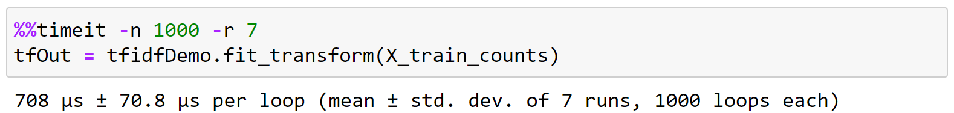
timeit (Magic Command in Jupyter Notebook)
We can find the time taken to execute a statement or a cell in a Jupyter Notebook with the help of timeit magic command.
This command can be used both as a line and cell magic:
In line mode you can time a single-line statement (though multiple ones can be chained with using semicolons).
In cell mode, the statement in the first line is used as setup code (executed but not timed) and the body of the cell is timed. The cell body has access to any variables created in the setup code.
Syntax :
Line : %timeit [-n<N> -r<R> [-t|-c] -q -p<P> -o]
Cell : %%timeit [-n<N> -r<R> [-t|-c] -q -p<P> -o]
Here, -n flag represents the number of loops and –r flag represents the number of repeats
Example :

